Slide 1
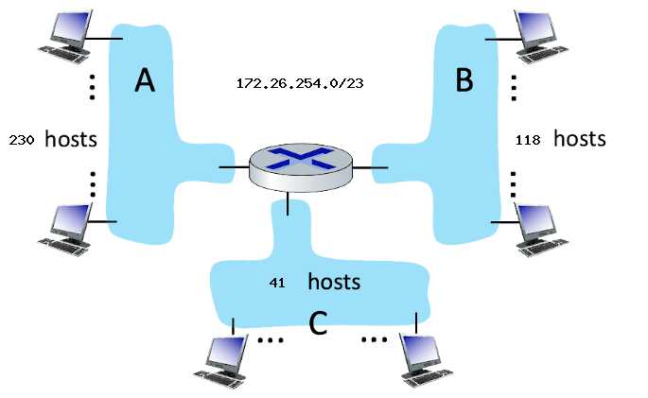
SUBNET ADDRESSING
Assign subnet addresses to each of the subnets (A, B, C) so that the amount of address space assigned is minimal, and at the same time leaving the largest possible contiguous address space available for assignment if a new subnet were to be added.

